Slide 1



Macrosystems EDDIE: Understanding Uncertainty in Ecological Forecasts
Moore, T. N., Lofton, M.E., Carey, C.C., Thomas, R. Q. 12 December 2023.
Macrosystems EDDIE: Introduction to Ecological Forecasting.
Macrosystems EDDIE Module 6, Version 2.
http://module6.macrosystemseddie.org
Module development supported by NSF DEB-1926050; NSF DBI-1933016
Notes:
Welcome the students to class.
It is important at this point to emphasize that there will be lots of new material covered during this module, and that going slowly and asking for help is very much encouraged!

Slide 2
Overview of today
Introduce the concepts of ecological forecasting and forecast uncertainty; where uncertainty comes from; how to quantify uncertainty; and steps to reduce forecast uncertainty
Activity A: Students build different models to simulate water temperature for their chosen NEON site and generate forecasts without uncertainty.
Activity B: Generate additional forecasts of water temperature and examine how different sources of uncertainty affect the different models.
Activity C: Quantify and partition the uncertainty for forecasts made using different models and make management decisions using an ecological forecast with uncertainty.
Notes:
Quick road map of what will be covered in this lesson
Overview slide for the day (will require instructor edits if adapting for different class lengths!)
Three classes (50-60 minutes)
Class 1 – Introductory lecture (30 min.) and completion of Activity A, Objectives 1 and 2 (20 min.)
Class 2 – Completion of Activity A, Objectives 3 and 4 (30 min.), and Activity B, Objectives 5 and 6 (20 min.)
Class 3 – Completion of Activity B, Objectives 7 and 8 (20 min.), and Activity C (20 min.); wrap-up (10 min.)
Two classes (75-90 minutes)
Class 1 – Introductory lecture and completion of Activity A
Class 2 – Activity B & C followed by 10-15 minute presentation discussion of each groups' results
One class (3 hours)
Introductory lecture – 30 mins, Activity A – 45 mins, break – 5mins, Activity B – 45 mins, group presentation/discussion – 15/20mins, Activity C – 30 mins

Slide 3
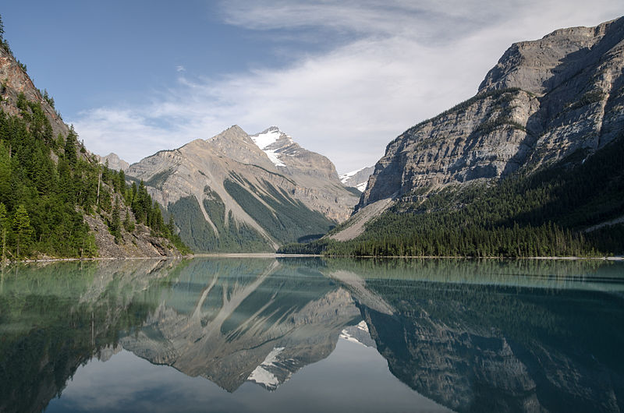
Ecosystems are changing worldwide…
In response to changes in climate and land use, ecological functioning in many aquatic and terrestrial systems is changing
Lakes and reservoirs provide many ecological services; thus, understanding how these ecosystems will change in the short-term will help us better manage these vital resources
Ecological forecasting is a potentially powerful tool to help lake and reservoir managers preemptively prevent or mitigate water quality concerns
Image: Wikimedia commons
Notes:
Big picture, we frame ecological forecasts in the context of changing climate and land use. Our focus today is on aquatic ecosystems: management of these resources could be improved by having advance knowledge of how they could potentially change in the near-term (e.g., 1 to 30 days in the future).
Why do we want to generate ecological forecasts? Answer: Because there is lots of variability in how climate change is occurring globally and lakes provide critical ecosystem services for humans, so ecological forecasts are critical to help management of these resources.

Slide 4
Before we start:
What is an Ecological Forecast?
A prediction of future environmental conditions
with uncertainty
Events have not yet occurred
Gives a probability or a likelihood of the event to occur (uncertainty)
Actionable
Notes:
Ask the class “What is a Forecast?” – if teaching virtually, prompt them to either type answers into the chat or raise their hand to ask the question. Key aspects of a forecasts are listed in the slide.
Actionable implies that the information is given in a time frame that allows for a response. For example, you could forecast air temperature five minutes into the future with relatively low uncertainty, but this is not much use compared to a forecast for air temperature three days into the future.
Highlight the inclusion of uncertainty, which is critical to give decision-makers a clear picture of the probability of different forecasted outcomes, and the focus of the module today.

Slide 5
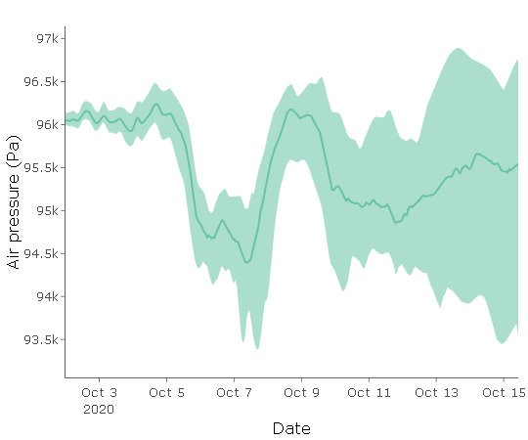
What is uncertainty?
?
?
Forecast uncertainty: the range of possible alternate future conditions predicted by a model.
We generate multiple different predictions of the future because the future is inherently unknown.
Uncertainty generally increases as the forecast horizon increases.
Forecast horizon: the length of time into the future for which a forecast is generated
Quantify Uncertainty
Plot showing 16-day-ahead forecast of air pressure with shaded regions showing 95% confidence interval and the solid line represents the median
Notes:
Forecast uncertainty: the range of possible alternate future conditions predicted by a model.
We generate multiple different predictions of the future because the future is inherently unknown.
Uncertainty generally increases with time into the future.
Here is a plot showing 16-day forecast of air pressure with shaded regions showing 95% confidence interval and the solid line represents the median. The confidence interval represents the uncertainty in the forecast.

Slide 6
Our focal question for today:
Where does forecast uncertainty come from and how can it be quantified and reduced?
Notes:
This leads to our focal question for this module: where does forecast uncertainty come from and how can it be quantified and reduced?
“Quantified” means that we are calculating a numerical value for our uncertainty

Slide 7




?
?
Quantify Uncertainty
Generate
Forecast
The Forecast Cycle
Build Model
Communicate Forecast
?
Create
Hypothesis
Assess Forecast
Update Model with Data
Notes:
Briefly (!!) introduce each point in the forecast cycle. Highlight that it is “iterative” which means that it is a repetitive process, hence why it is described as a cycle
Create Hypothesis – use the example of how primary productivity is affected by water temperature and underwater light.
Build Model – use data to build a mathematical model to describe the observations of water temperature. Driver data are variables (such as future water temperature and underwater light) which can be used to drive the model.
Quantify uncertainty – this is a key step. There are several different types of uncertainty sources that could be included: e.g., driver, process, parameter, initial conditions.
Generate Forecast – using the model built for generating a forecast of primary productivity.
Communicate Forecast – potential forecast users could include a water resource manager for a drinking water reservoir. There are different ways to communicate a forecast, but this is a critical step as a forecast is not effective for helping management if it is not communicated effectively to end users.
Assess forecast – As time goes on, new data are collected and then this can be compared to previous forecasts to assess how accurate the forecast was.
Update model – if the model is not accurately predicting observations, the model can be updated by changing the model parameters, adding a new driver variable; additionally, a model can be updated via data assimilation, which is using the most recent observations to update the model’s initial, or starting, conditions to ensure the most accurate possible forecast
In this module, we will be focusing on building a model, quantifying the uncertainty associated with our forecast, and generating a forecast.

Slide 8


Ecological models
A model is a simplified representation of a real phenomenon, with the goal of understanding and predicting that phenomenon
Predicting water temperature in a lake
y = mx + b
y
t
Notes:
We will use ecological models to generate our forecasts
An ecological model is a simplified representation of nature, with the goal of understanding and predicting environmental dynamics
A simple version of a model is a linear model: “y = mx + b”, and today we will be using a model to predict water temperatures in a lake, where today’s surface water temperature is the "y" in the equation and the “x” will be other drivers such as yesterday’s surface water temperature and air temperature.

Slide 9
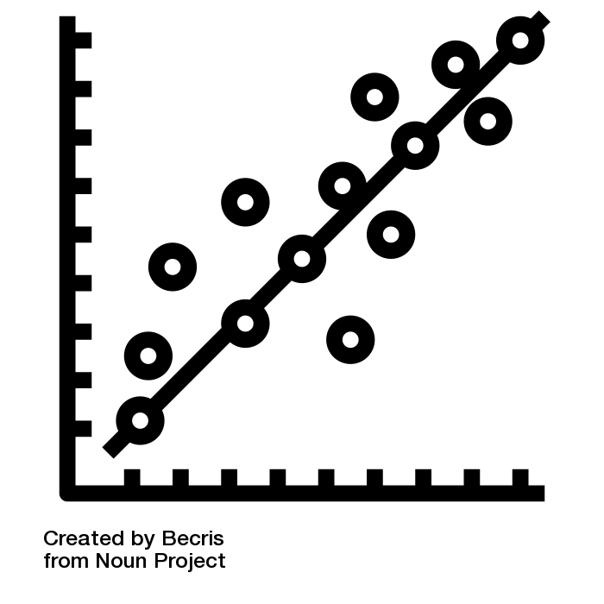

Models are inherently uncertain
Sources of uncertainty:
Process uncertainty
Water temp
Air temp
Process uncertainty is uncertainty caused by our inability to model all processes as observed in the real world.
model process
y = mx + b
Water temp
Air temp
Notes:
Ecological models are inherently uncertain as our data are imperfect and we cannot perfectly represent the real world. Uncertainty in ecological models can arise from a number of sources.
For example, process uncertainty is uncertainty caused by our inability to model all processes as observed in the real world. Here, we are modeling the effect of air temperature on water temperature, but we may be missing other important processes that affect water temperature, such as inflows to the lake, and that leads to process uncertainty.
In a linear regression, process uncertainty can be thought of as uncertainty in the structure of the model equation (y = mx + b) – maybe there is another equation that would better represent water temperature processes.

Slide 10
Models are inherently uncertain
Sources of uncertainty:
Process uncertainty
Parameter uncertainty
Water temp
Air temp
Parameter uncertainty refers to the uncertainty in the model parameter values, which can be due to having a limited set of data used to calibrate a model.
parameters
y = mx + b
Notes:
Second, parameter uncertainty refers to the uncertainty in the model parameter values, which can be due to uncertainties in the data or the calibration process used. For example, if we were to refit this linear model with an additional year of data or using data from a different type of temperature sensor, our parameter values might change slightly, leading to parameter uncertainty.
In a linear regression, parameter uncertainty refers to uncertainty in the values of the slope (m) and intercept (b) parameters.

Slide 11

Models are inherently uncertain
Sources of uncertainty:
Process uncertainty
Parameter uncertainty
Initial conditions uncertainty
Water temp
tmrw
Water temp
today
Initial conditions uncertainty refers to uncertainty arising because the current conditions in an ecosystem are not precisely known.
initial condition
y_{t+1} = my_{t} + b
Water temp
tmrw
Water temp
today
Notes:
Third, initial conditions uncertainty refers to uncertainty arising because the current conditions in an ecosystem are not precisely known. For example, suppose we have a model that uses today’s water temperature to predict tomorrow’s water temperature. We would consider today’s water temperature to be the initial condition. But we may not have a water temperature observation every day, and so we do not know what the current water temperature conditions are in the lake, leading to initial conditions uncertainty. Additionally, even if we do have a measurement every day, there is observation uncertainty associated with that measurement.

Slide 12
Models are inherently uncertain
Sources of uncertainty:
Process uncertainty
Parameter uncertainty
Initial conditions uncertainty
Driver data uncertainty
Water temp
Air temp
Driver uncertainty comes from inaccuracies in the forecasted variables used to drive the model.
driver data
y = mx + b
Water temp
Air temp
Notes:
Finally, driver data uncertainty comes from inaccuracies in the forecasted variables used to drive the model. For example, we all know that air temperature forecasts are not perfect. If we are using an air temperature forecast as input to our linear regression to forecast water temperature, imperfections in the air temperature forecast will translate to imperfections in the water temperature forecast, leading to driver data uncertainty.
In a linear regression, driver data uncertainty refers to uncertainty in x, which in this case is air temperature.

Slide 13
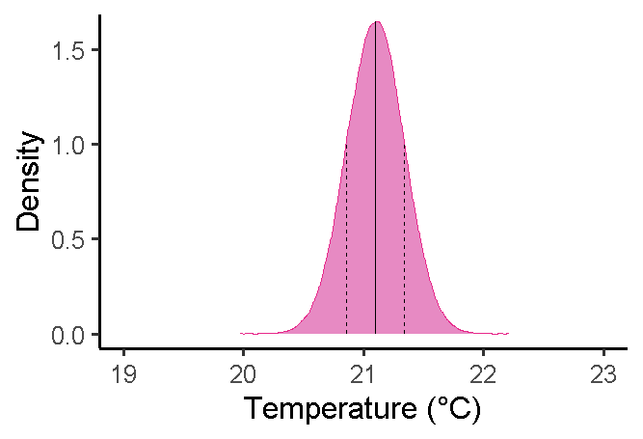
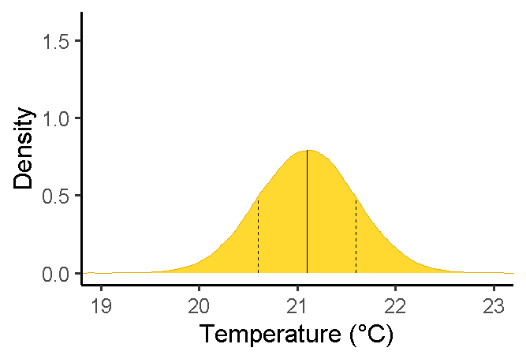
Using Distributions to Represent Uncertainty
A. Low Uncertainty
Uncertainty can be represented as a distribution of all possible values
Here, uncertainty is represented as a normal distribution around the mean of 21.1°C with:
Low uncertainty
High uncertainty
B. High Uncertainty
Notes:
We can represent uncertainty using distributions, which describe all the possible values a variable of interest might have and how likely those values are. Here are two examples of distributions of possible water temperature with low uncertainty (A) and high uncertainty (B).

Slide 14
Deterministic vs. Probabilistic Forecasts
Deterministic forecast
A single line represents the future
Uncertainty is not accounted for
Probabilistic forecast
The range of future outcomes are represented with a likelihood of each occurring
Uncertainty is accounted for
Past
Future
Past
Future
Notes:
Furthermore, we can use distributions to generate probabilistic, as opposed to deterministic, forecasts.
Deterministic forecasts do not include uncertainty and predict the future as a single value (represented by a single line in the figure).
Probabilistic forecasts do include uncertainty and predict the future as a range of possible outcomes, where the range of possible outcomes corresponds to a distribution, such that some outcomes are more likely than others.

Slide 15
Ensemble forecasts
Instead of running just a single forecast, a model is run multiple times with slightly different conditions, often based on a distribution of possible values
The complete set of forecasts is referred to as the ensemble.
Individual forecasts within it are ensemble members.
Commonly, each member of the ensemble is equally likely to occur.
This allows us to generate a probabilistic forecast!
Past
Future
Value
75%
Ensemble
95%
Member
t-2
t-1
t
t+1
t+2
Notes:
Ensemble forecast – talk through the animation. Emphasize that each member of the ensemble is a potential future path and has an equally likely chance of occurring.
To generate an ensemble forecast, instead of running just a single forecast, a model is run multiple times with slightly different conditions, often based on a distribution of possible values
The complete set of forecasts is referred to as the ensemble
Individual forecasts within it are ensemble members
Commonly, each member of the ensemble is equally likely to occur
This allows us to generate a probabilistic forecast

Slide 16
Managing Forecast Uncertainty
Step 1: Quantify uncertainty
What is the magnitude of uncertainty?
From what source(s) does uncertainty arise?
Step 2: Reduce uncertainty
Past
Future
parameters
y = mx + b
Notes:
Often, it is beneficial to reduce the uncertainty in a forecast to give decision-makers a clearer picture of what the future might hold. There are two steps to managing forecast uncertainty. The first step is to quantify uncertainty, which involves determining the magnitude of uncertainty in a forecast and from which sources it arises.

Slide 17
Managing Forecast Uncertainty
Step 1: Quantify uncertainty
Step 2: Reduce uncertainty
Methods for reducing forecast uncertainty depend on which source of uncertainty you are trying to reduce
Type of uncertainty | Approach | How it works
Process | Improve the forecast model | Changing the model structure to better reflect the real world can reduce process uncertainty
Notes:
The second step is reducing forecast uncertainty. Methods for reducing forecast uncertainty depend on which source of uncertainty you are trying to reduce.
For example, if you determine that process uncertainty is a large source of uncertainty to your forecast, you might try to improve the forecast model by changing the model structure to better reflect processes that are occurring in the real world. In our case, we might try to change the model structure to account for the effect of inflows on lake water temperature, for example.

Slide 18
Managing Forecast Uncertainty
Step 1: Quantify uncertainty
Step 2: Reduce uncertainty
Methods for reducing forecast uncertainty depend on which source of uncertainty you are trying to reduce
Type of uncertainty | Approach | How it works
Process | Improve the forecast model | Changing the model structure to better reflect the real world can reduce process uncertainty
Parameter | Collect more data | Collecting data on key parameters, such as growth rates, can reduce parameter uncertainty
Notes:
If you determine that parameter uncertainty is a large source of uncertainty to your forecast, you might try to improve the forecast model by collecting more data on key parameters. For example, if you are trying to forecast abundance of fish in a lake, you might collect additional data on fish growth and mortality rates to better parameterize your model.

Slide 19
Managing Forecast Uncertainty
Step 1: Quantify uncertainty
Step 2: Reduce uncertainty
Methods for reducing forecast uncertainty depend on which source of uncertainty you are trying to reduce
Type of uncertainty | Approach | How it works
Process | Improve the forecast model | Changing the model structure to better reflect the real world can reduce process uncertainty
Parameter | Collect more data | Collecting data on key parameters, such as growth rates, can reduce parameter uncertainty
Initial conditions | Collect more data | Collecting more frequent data can give a more accurate picture of current ecological conditions, reducing initial conditions uncertainty
Notes:
If you determine that initial conditions uncertainty is a large source of uncertainty to your forecast, you might try to reduce forecast uncertainty by collecting more frequent data so that current conditions in the ecosystem at any given time are more precisely known. For example, if you are trying to forecast water temperature, you might install a sensor that collects water temperature data every hour, reducing initial conditions uncertainty.

Slide 20
Managing Forecast Uncertainty
Step 1: Quantify uncertainty
Step 2: Reduce uncertainty
Methods for reducing forecast uncertainty depend on which source of uncertainty you are trying to reduce
Type of uncertainty | Approach | How it works
Process | Improve the forecast model | Changing the model structure to better reflect the real world can reduce process uncertainty
Parameter | Collect more data | Collecting data on key parameters, such as growth rates, can reduce parameter uncertainty
Initial conditions | Collect more data | Collecting more frequent data can give a more accurate picture of current ecological conditions, reducing initial conditions uncertainty
Driver | Improve driver forecast | A more accurate driver forecast with lower uncertainty will lead to lower driver uncertainty
Notes:
If you determine that driver data uncertainty is a large source of uncertainty in your forecast, you might try to reduce it by improving the accuracy of your driver data forecast. For example, if you are using an air temperature forecast as input to generate a water temperature forecast, improving the quality of the air temperature forecast will reduce driver data uncertainty in the water temperature forecast.

Slide 21
Today…
We are going to generate forecasts of water temperature in lakes using ecological models calibrated to real data from the National Ecological Observatory Network (NEON).
We will explore the sources of your forecast’s uncertainty, quantify its uncertainty, and learn how to manage the uncertainty of your forecast.
Notes:
We are going to generate forecasts of water temperature in lakes using ecological models calibrated to real data from the National Ecological Observatory Network (NEON).
We will explore the sources of your forecast’s uncertainty, quantify its uncertainty, and learn how to manage the uncertainty of your forecast.

Slide 22
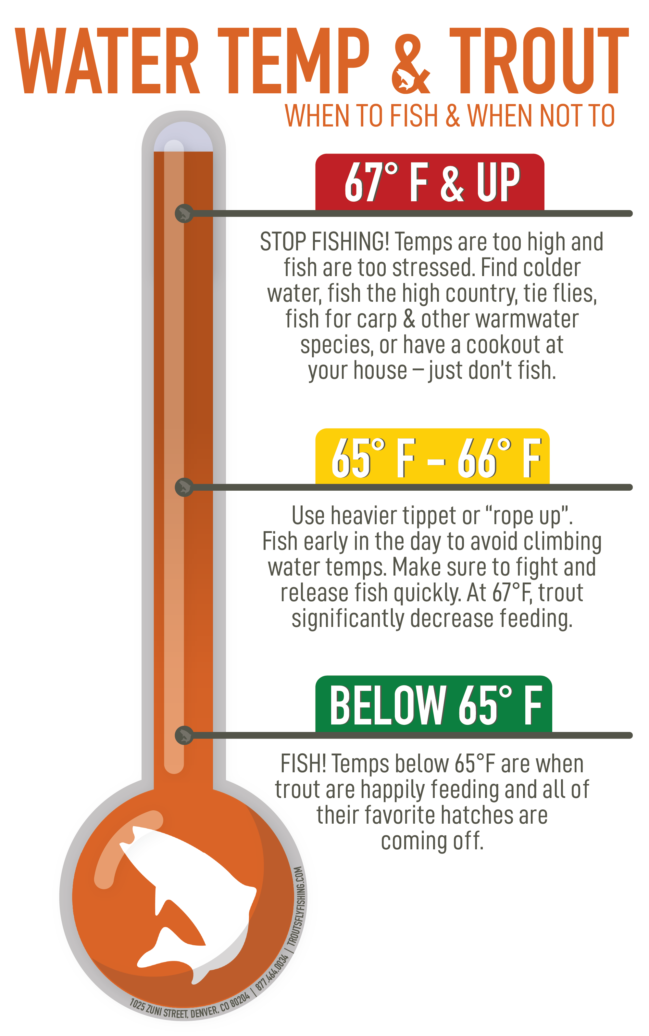
Water temperature
Water temperature influences
Biological activity and growth
Water chemistry
Biodiversity
Water quality
Land use change and climate change can affect water temperature
Predicting future water temperatures can help resource managers prevent water quality degradation
TroutFlyFishing.com
Notes:
Water temperature exerts a major influence on biological activity and growth, has an effect on water chemistry, can influence water quantity measurements, and governs the kinds of organisms that live in water bodies.
For example, trout do best in a certain range of water temperature, and above this temperature they are more likely to exhibit stress signals.
Freshwater ecosystems are currently experiencing a multitude of stressors such as land use change and climate change.
Being able to predict how such systems can change in the short-term (up to 7 days into the future) will provide natural resource managers with critical information to take pro-active actions to prevent degradation of water quality.

Slide 23
Forecast models
We will be forecasting future water temperature using four simple models:
=
Water temp
Water temp
t+1
t
Persistence model
Notes:
Today, we will be forecasting future water temperature using four simple models. First, we will use a persistence model, which states that water temperature tomorrow (t+1) is equal to water temperature today (t).

Slide 24
Forecast models
We will be forecasting future water temperature using four simple models:
=
Water temp
Water temp
t+1
t
= m × + b
Water temp
Water temp
t+1
t
= m × + b
Water temp
Air temp
t+1
t+1
Linear regression models
Notes:
Next, we will use two linear regression model: one that uses today’s water temperature to predict tomorrow’s water temperature with some slope (m) and intercept (b), and one that uses a forecast of tomorrow’s air temperature to predict tomorrow’s water temperature, with some slope (m) and intercept (b).

Slide 25
Forecast models
We will be forecasting future water temperature using four simple models:
=
Water temp
Water temp
t+1
t
= m × + b
Water temp
Water temp
t+1
t
= m × + b
Water temp
Air temp
t+1
t+1
Water temp
= β₀ +β₁ × + β₂ ×
Water temp
Air temp
t+1
t
t+1
Multiple linear regression model
Notes:
Finally, we will use a multiple linear regression model that uses both today’s water temperature and tomorrow’s forecasted air temperature to forecast tomorrow’s water temperature. In this model, there are three model parameters: two coefficients for the air temperature and water temperature predictors (beta 1 and beta 2) and an intercept (beta 3).

Slide 26
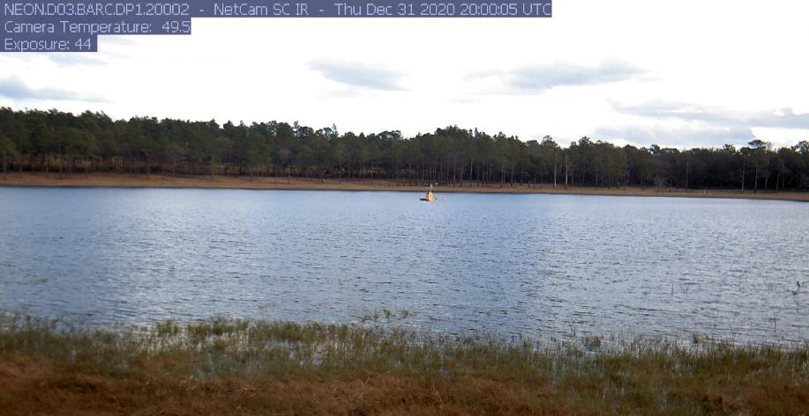
National Ecological Observatory Network (NEON)
We will be forecasting water temperature at NEON sites
NEON is a continental-scale observatory designed to collect long-term open-access ecological data to better understand how U.S. terrestrial and aquatic ecosystems are changing
Image: Phenocam
Notes:
We will be forecasting water temperature at National Ecological Observatory Network (NEON) sites
NEON is a continental-scale observatory designed to collect long-term open access ecological data to better understand how U.S. terrestrial and aquatic ecosystems are changing. Today we will be forecasting water temperature at NEON lake sites.

Slide 27
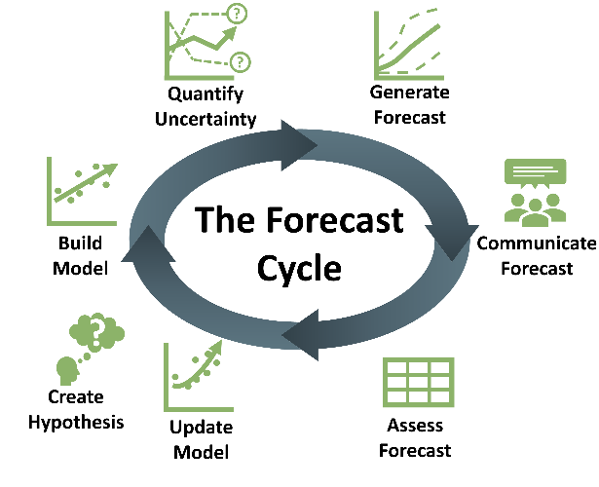
Learning objectives of today’s module:
Define ecological forecast uncertainty
Explore the contributions of different sources of uncertainty to total forecast uncertainty
Understand how multiple sources of uncertainty are quantified
Identify ways in which uncertainty can be reduced within an ecological forecast
Describe how forecast horizon affects forecast uncertainty
Explain the importance of specifying uncertainty in ecological forecasts for forecast users and decision support
Notes:
Learning objectives!
Talk through these with the students one by one: use the embedded animations to sequentially show each of the six bullet points.

Slide 28
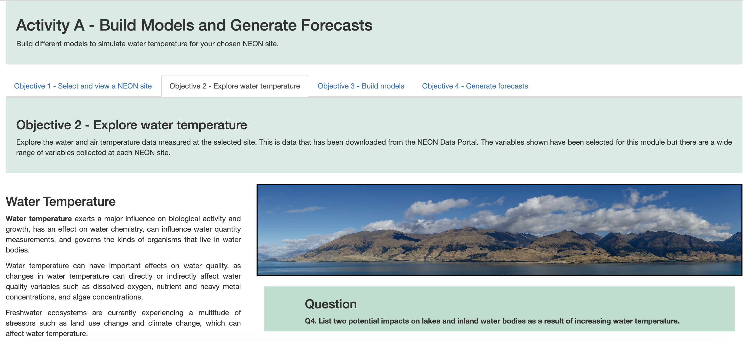
Activity A
With a partner (work in pairs):
Objective 1: Select a lake site
Objective 2: Explore water and air temperature data
Objective 3: Build water temperature forecast models
Objective 4: Generate deterministic forecasts
Notes:
Introduce Activity A, which has four objectives (have students work in pairs).
Select a lake site
Explore water and air temperature data
Build water temperature forecast models
Generate deterministic forecasts

Slide 29
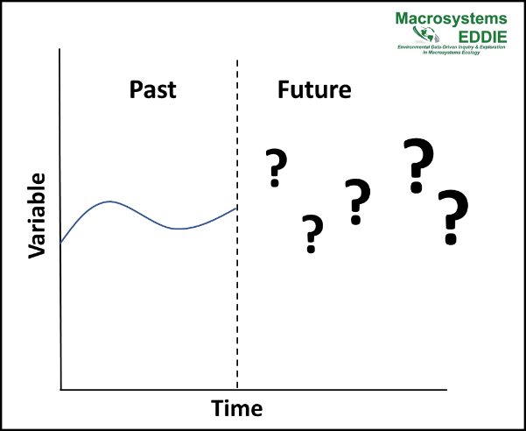
Activity B
With a partner (work in pairs):
Explore forecast uncertainty and compare how different sources of uncertainty affect the different models.
Objective 5: Process uncertainty
Objective 6: Parameter uncertainty
Objective 7: Initial conditions uncertainty
Objective 8: Driver uncertainty
Notes:
Activity B – continue working in pairs and answer the questions individually. Explore forecast uncertainty and compare how different sources of uncertainty affect the different models. Each objective will explore one source of uncertainty.
Process uncertainty
Parameter uncertainty
Initial conditions uncertainty
Driver uncertainty

Slide 30
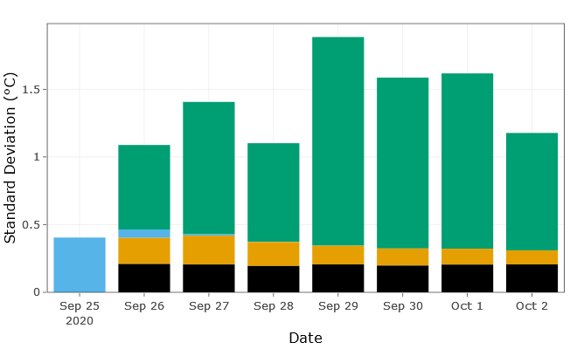
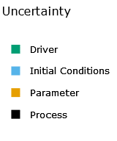
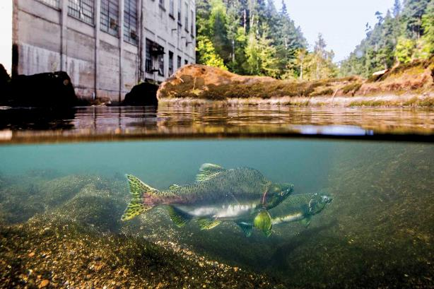
Activity C
With a partner (work in pairs):
Objective 9: Generate forecasts with total forecast uncertainty and quantify the different contributions of each source of uncertainty to forecasts
Objective 10: Decide from which depth to release water from a reservoir using forecasts which include uncertainty
Source
Notes:
Activity C – this activity has two objectives
Generate forecasts with total forecast uncertainty and quantify the different contributions of each source of uncertainty to forecasts
Decide from which depth to release water from a reservoir using forecasts which include uncertainty

Slide 31

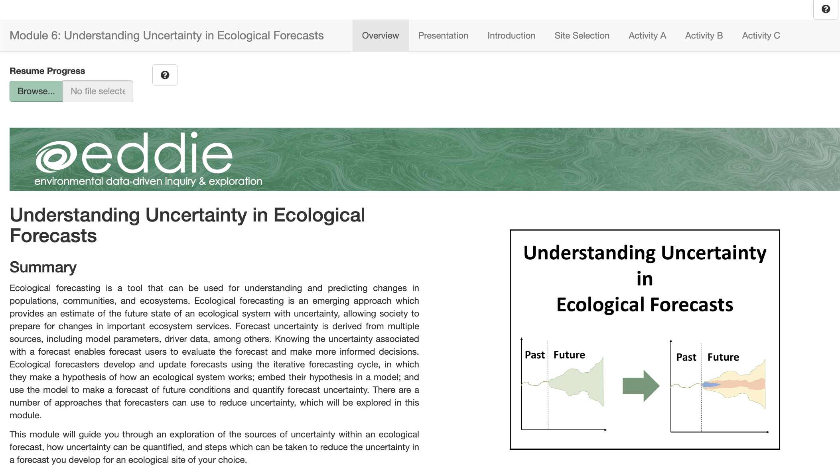
Shiny App
The module can be accessed at: https://macrosystemseddie.shinyapps.io/module6/
This is an interactive webpage built using R
It has interactive plots and options embedded which allow you to build your own personal model, visualize and explore the data, and answer questions
Notes:
Shiny App:
The module can be accessed at: https://macrosystemseddie.shinyapps.io/module6/
This is an interactive webpage built using R code
It has interactive plots and options embedded which allow you to build your own personal model, visualize and explore the data, and answer questions

Slide 32
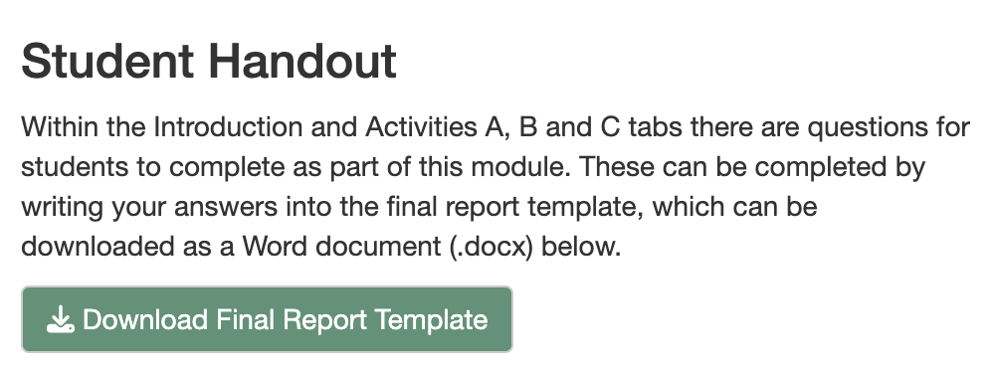
Downloading the Report
Navigate to the “Introduction” tab
Click on the “Download Final Report Template” button to download a Word document into which you can type your answers.
Notes:
Generating the student report. At this point, the instructor may choose to navigate to the Shiny app and demonstrate its features while screen sharing the app in a browser. Alternatively, the instructor may cover the material on slides 32-34 in PowerPoint.

Slide 33
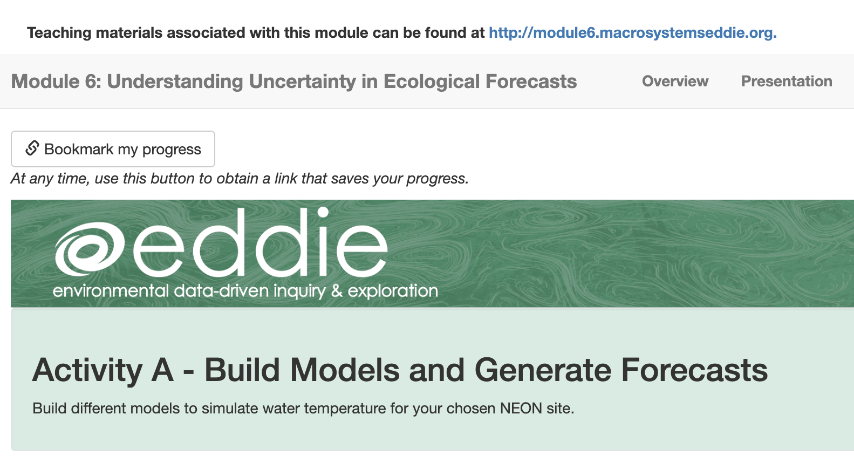
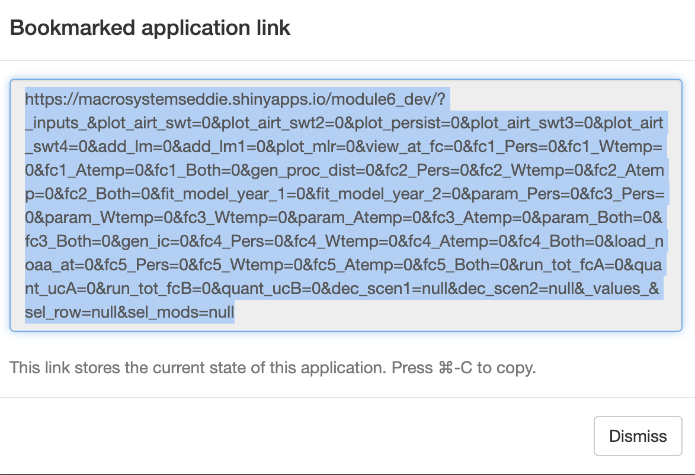
Saving & Resuming Progress
Saving Progress
Scroll to top of the page.
Click on the “Bookmark my progress” button. A pop-up window with a very long link will appear.
Copy-paste the link and store it at the top of your final report.
Resuming progress
Open your browser.
Copy-paste the link into your browser.
As you navigate through the tabs in the module, your progress will reappear.
Notes:
Saving & resuming progress in the Shiny app.

Slide 34
We recommend that you save your progress often!
Because the Shiny app can time out after inactivity (15 minutes) or disconnect if an internet connection is interrupted, we don’t want you to lose your work.
Save your progress as you go, as well as every time you close your computer or close the Shiny app in your internet browser.
After you save the link somewhere safe, you should be able to resume your progress where you left off!
Notes:
We recommend that you save your progress often!

Slide 35
Let’s Go!
For the activity we will work in pairs.
Each pair selects the same NEON site and works through Activities A, B, and C.
It is possible that more than one pair will be assigned to the same lake.
https://macrosystemseddie.shinyapps.io/module6/
Lake name | Students
Barco Lake
Prairie Pothole
Little Rock Lake
Notes:
Help students transition over to the Shiny app and get started. Instructors may use the table to record which students are working with which lake sites, if helpful.

Slide 36
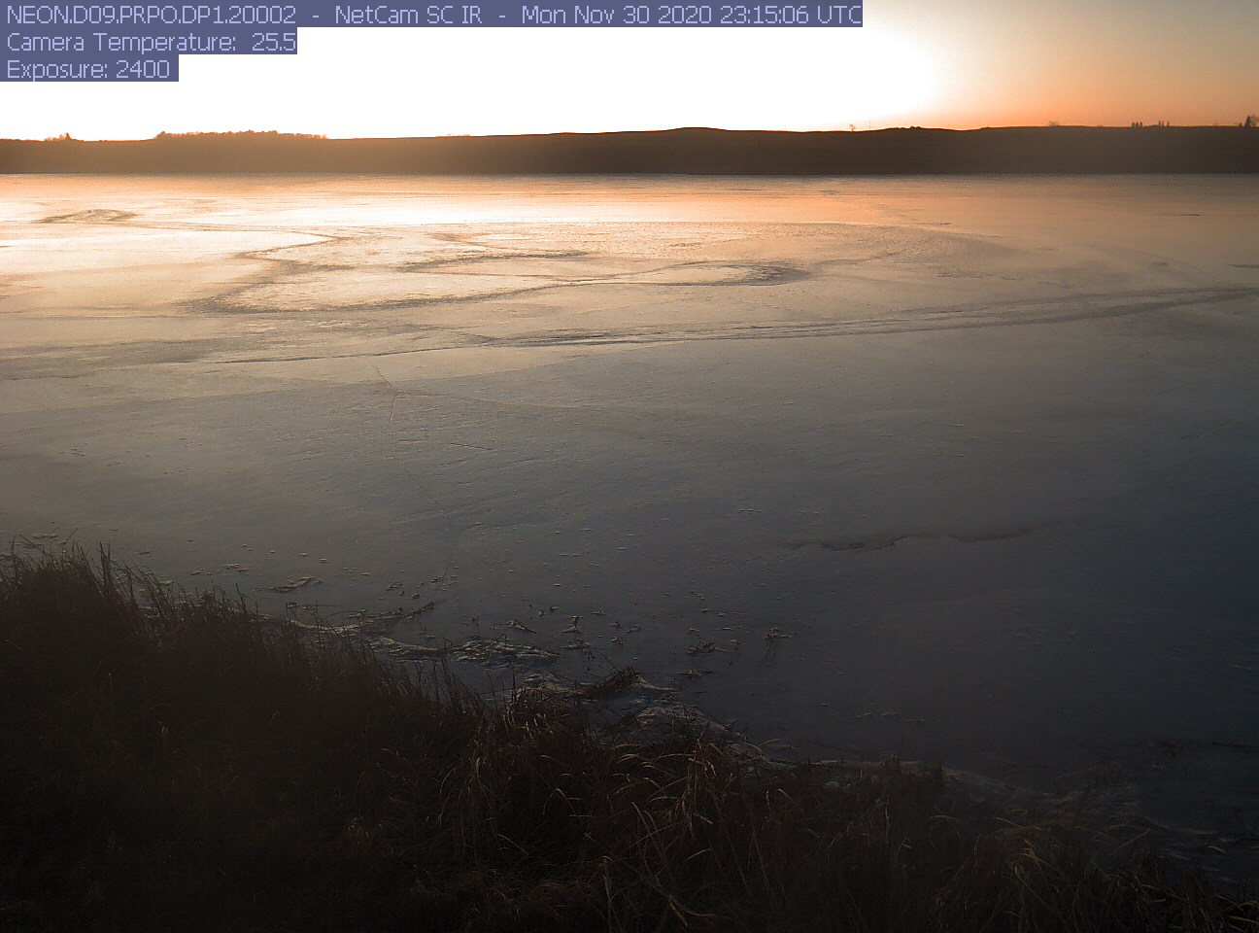


Thank you for participating!
Check out other ecological forecasting modules:
Module 5: Introduction to Ecological Forecasting
Module 7: Using Data to Improve Ecological Forecasts
Module 8: Using Ecological Forecasts to Guide Decision-Making
Find out more at: macrosystemsEDDIE.org
Notes:
Thank you for participating! If you would like to learn more, please check out the other Macrosystems EDDIE ecological forecasting modules.

